Slide 1
Meeting Part 2:
Computer Maintenance & Password Security
Intermediate Computing Group
Purbeck U3A Wed 28th March 2012
Ian Mackenzie

Slide 2
Topics for Discussion
1. Housekeeping – dealing with temporary files.
2. An idea for memorable passwords

Slide 3
1. Housekeeping
Dealing with superfluous temp files
Using Disk Cleanup
Defragmenting
Tuning the Registry

Slide 4
Dealing with Temporary Files
Using %Temp% in Run window
Deleting temp files in Windows/temp folder
Use of utility e.g. TempClean
Notes:
Dealing with these files can speed up your computer working
The paint dries a little more quickly!

Slide 5
Finding ALL Temp Files
%Temp% reveals them all!
Block them with the mouse
Delete!
(If you use <SHIFT><DEL> it bypasses the trashcan)
Notes:
There are other temp file types e.g. log, bu, tmp etc. But these are the main culprit!
To pick up others use the other methods!
(demo)

Slide 6
Windows Temp Folder
Biggest culprit!
Use short-cut to C:/Windows/Temp
Block & delete as for ‘temp’ files
Notes:
Windows is very untidy in its work – it leaves many files around
Although often zero in length(0kB) they can clog up the working

Slide 7
TempClean
Freeware
Easily downloaded from the web
http://software.addpcs.com - Java 1.6 is required
Notes:
It does everything that MS Disk Clean does – and more!
It’s MS Vista certified!
Why it requires Java I do not know??

Slide 8
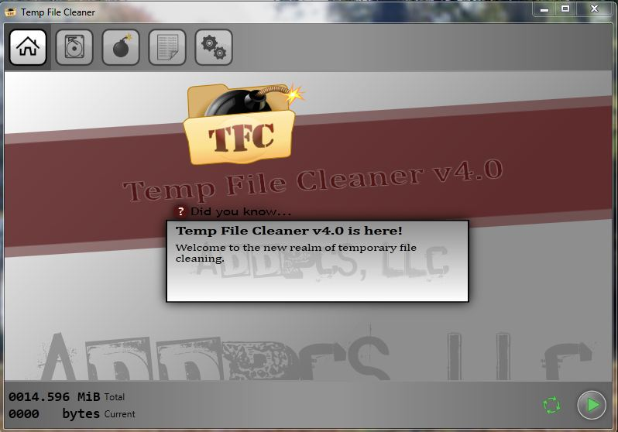
Notes:
This is the Settings tab on the utility
This shows the range of file types that you can select to delete
Some of these are covered by Windows Disk Cleanup

Slide 9
Use Disk Cleanup
A good MS utility
Clears out internet trash as well as temp files and trashcan
You can select what to remove and what to leave
Notes:
Can help a lot if used regularly!
A desktop shortcut to makes it easy to use regularly
(demo)

Slide 10
Using the Defragmenter
Broken up files on hard drive
Linking the parts

Slide 11
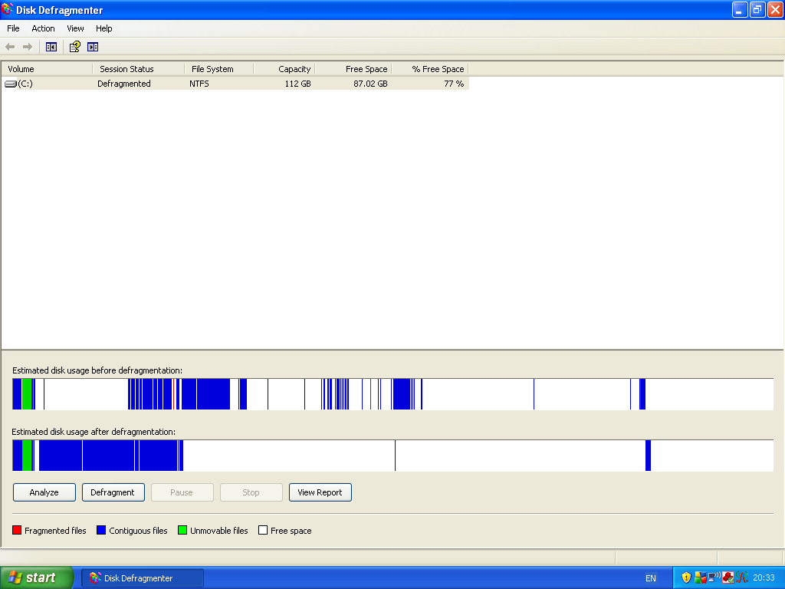
Analysis & Defragmentation
Notes:
Analysis is the top bar and the end result after defrag is the bottom
Where file chunks are all broken up the computer processor has to do a lot of ‘fetching and carrying’
In particular red bits show broken files.
Defrag can take an hour to do
It can take a day or two if you leave it too long
Suggest defrag once a month?

Slide 12
Tuning the Registry
“Command Centre” for all programmes
Needs clearing up of ‘loose ends’
Various packages available

Slide 13
Registry Tuning Packages
Commercial e.g. Registry Mechanic
£20 per year!
Freeware e.g. RegCure
Notes:
I have used both
Registry Mechanic involves an annual licence - £30 per year
Available from PCTools at www.pctools.com.
You can download a trial version. It offers compression of registry as well as a clear out
I now use RegCure. It is free and offers a ‘manage startup’ feature for the registry.
(demo)
Do NOT use RegClean – I tried downloading and installing it and AVG trapped it as carrying a trojan virus.

Slide 14
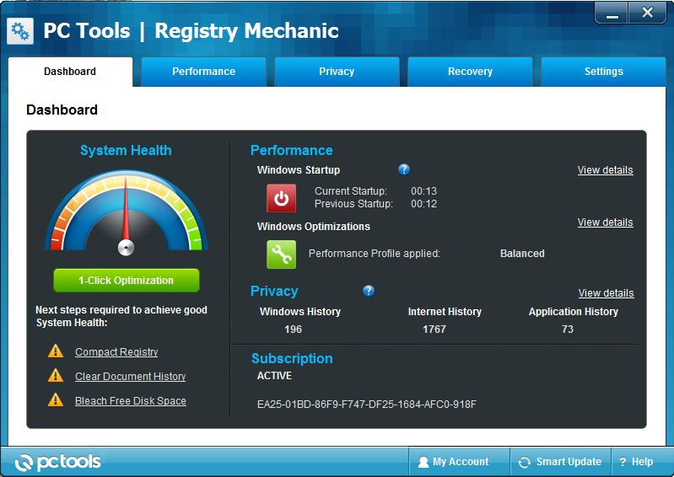
PC Tools Registry mechanic – opening screen

Slide 15
2. Memorable Passwords – an idea!
You need:
1. Old house number + street/road
2. Locality of the road
The further back in your memory the better – old lasts longer!
Notes:
Firewalls prevent access from outside to your computer without permission from you.
You can set the level of permission required.
Wireless security is necessary to prevent unauthorised access to your router (and possibly computer).
Signals can pass to and fro between wireless router and computer(laptop) via em radiation.
Works at frequency of 2.4GHz.

Slide 16
The password
Make up your password from number+road OR road+number
e.g. 16overslade OR overslade16
Best to use lower case throughout
Notes:
You can use the Windows firewall, the firewall offered by your anti-virus software or possibly even router.
You have choice of two or three levels of wireless security to choose from.

Slide 17
Memory Aid
Record the locality with the length of the P/W
E.g. as 16overslade is in Bilton and is 11 characters long….
So memory aid is: 11Bilton

Slide 18
Memory Aid Plus!
Note that the length tells you where the digits are……
It also gives you an extra memory jog as to the length
You can record this fairly confident that it cannot be decoded….

Slide 19
Happy passwords!!

Slide 20
The End!

